Slide 1
Cell-free systems – what is it good for?

Slide 2
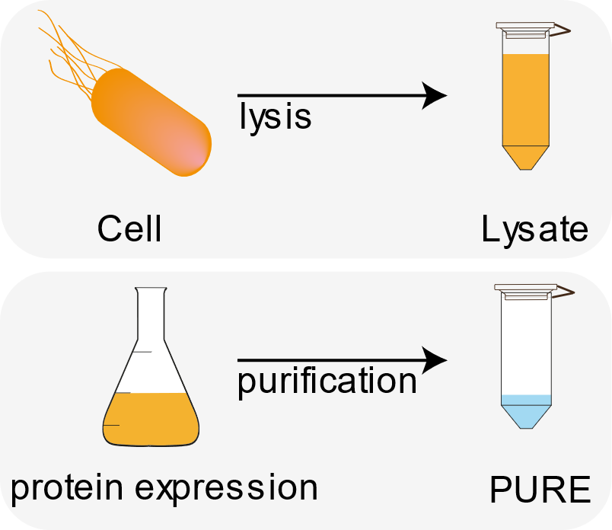
Cell-free systems
Idea: take the cellular transcription / translation out of the cell!

Slide 3
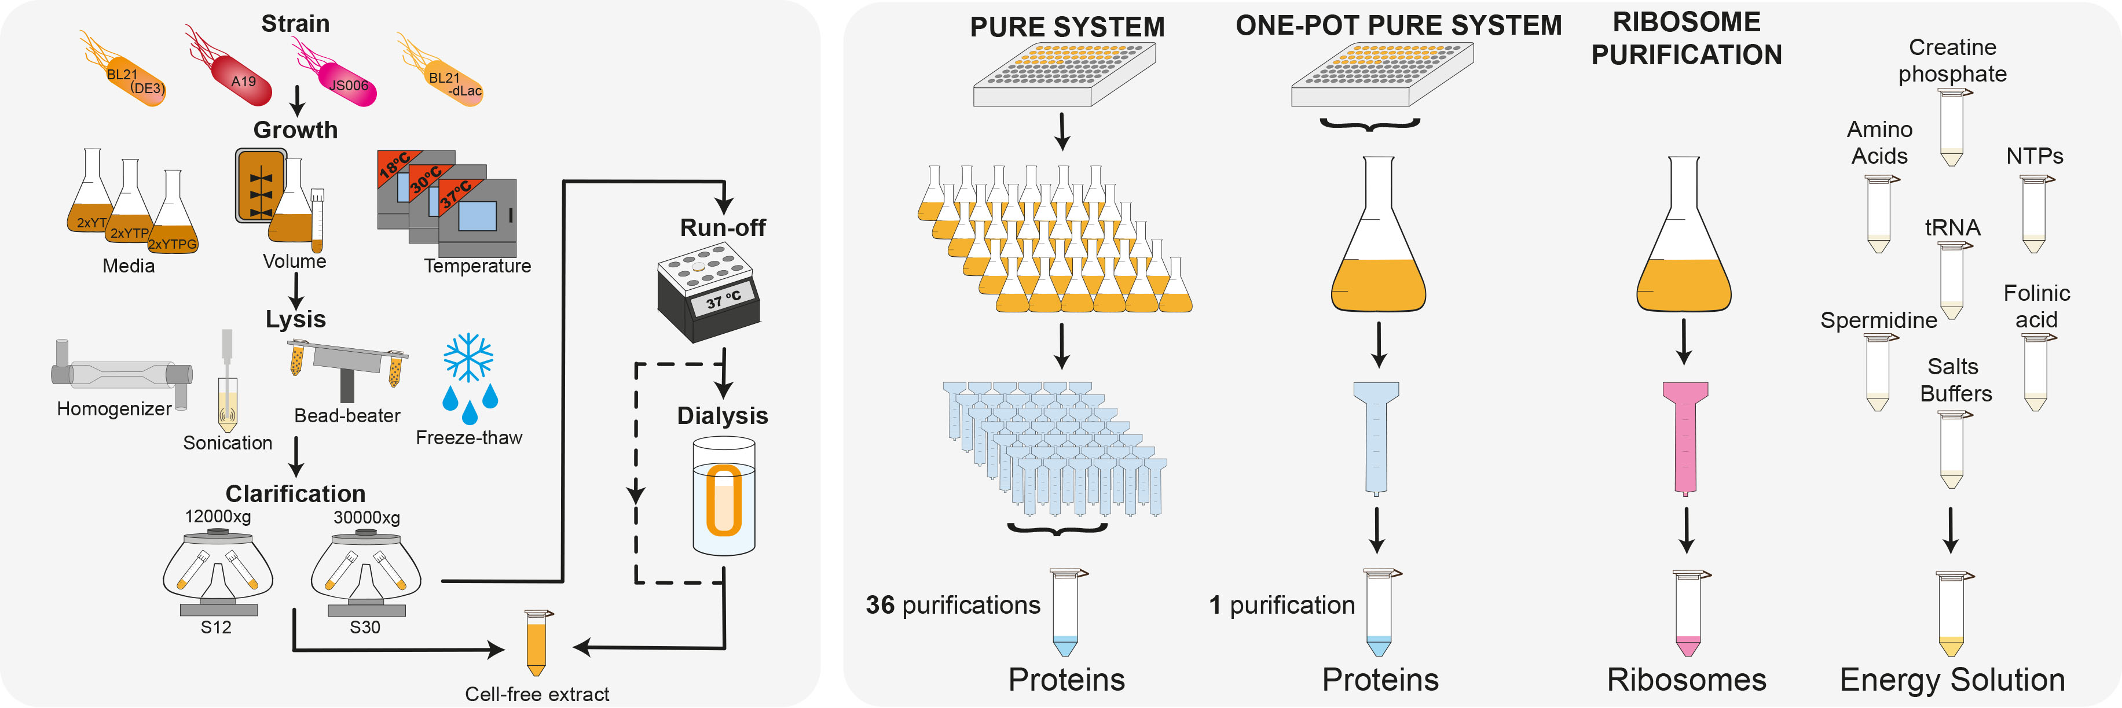
Lysate vs PURE
Lysate
PURE
adapted from: Laohakunakorn et al., Frontiers in Bioengineering and Biotechnology, 2020

Slide 4
Lysate vs PURE
Lysate
PURE
Has been around forever
High yield
Cheap and easy to make
Many different systems available
Undefined and complex
→ Black box
Since 2001
Less active
Expensive and laborious to make
Only E. coli based
Well-defined and comparably well understood
→ Less of a black box

Slide 5
Applications
Basic science: understanding biological systems better
Rapid prototyping
Diagnostics
Therapeutics
Metabolic engineering
Building a synthetic cell
Tinafar 2019

Slide 6
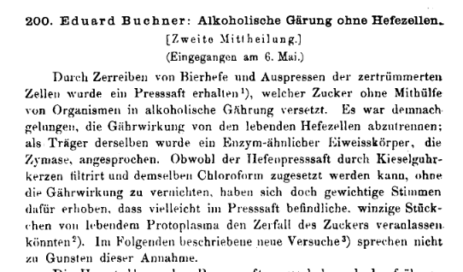
Basic science: the probably oldest cell-free experiment
1897: Buchner: Alcoholic fermentation is independent from living organisms (yeast) but due to enzymes.

Slide 7
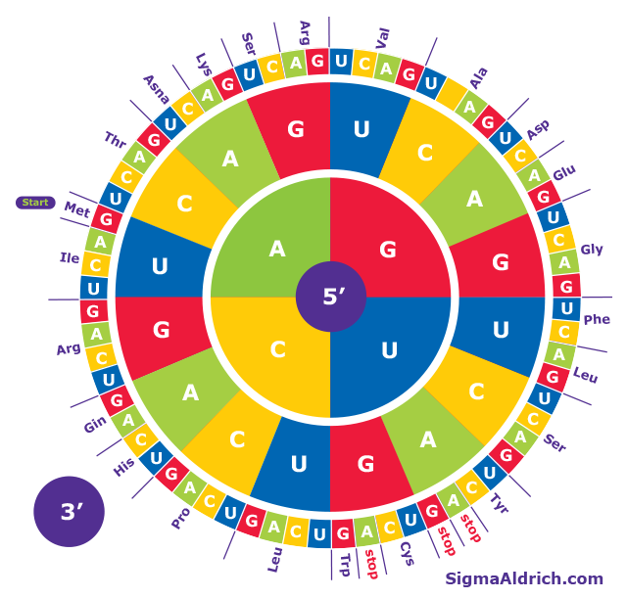
Basic science: Deciphering the genetic code
1960s Nirenberg and coworkers deciphered codon usage in living organisms → Nobel prize 1968

Slide 8
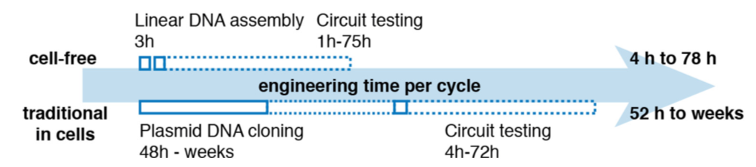
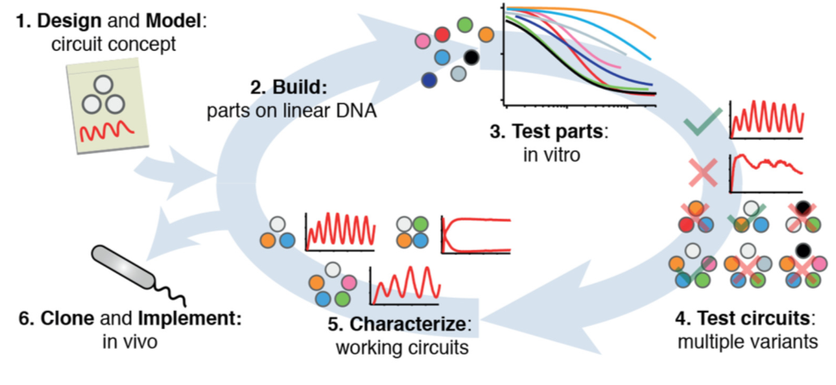
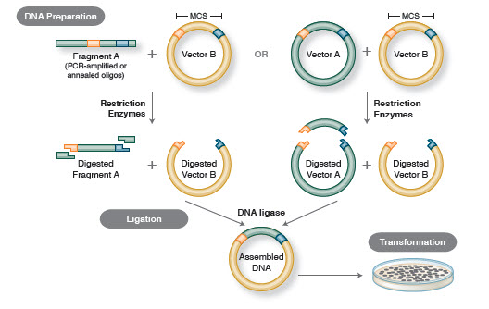
Rapid prototyping: cell-free is a lot faster!
Niederholtmeyer et al. eLife 2015.
https://international.neb.com/tools-and-resources/feature-articles/foundations-of-molecular-cloning-past-present-and-future

Slide 9
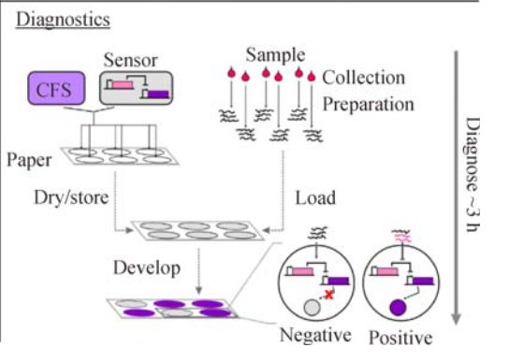
Diagnostics: Biosensors
Detection of small molecules (e.g. Mercury)
Detection of nucleic acids (Zika virus)
Villarreal 2017

Slide 10
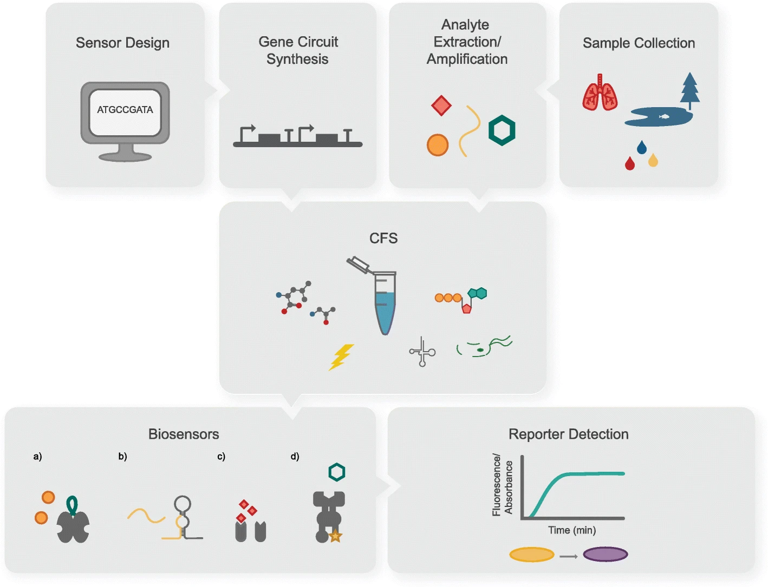
Diagnostics: Biosensors
Detection of small molecules (e.g. Mercury)
Detection of nucleic acids (Zika virus)
Tinafar 2019

Slide 11
Therapeutics
What
And why?
Antibodies
Vaccines
Antimicrobials including Bacteriophages
...
Rapid prototyping
Fast production
Personalized medicine (antibodies) → don‘t need huge quantities
Toxic components can‘t kill a cell

Slide 12
Therapeutics / Biomolecular Manufacturing
Pardee et al. Cell 2016.

Slide 13
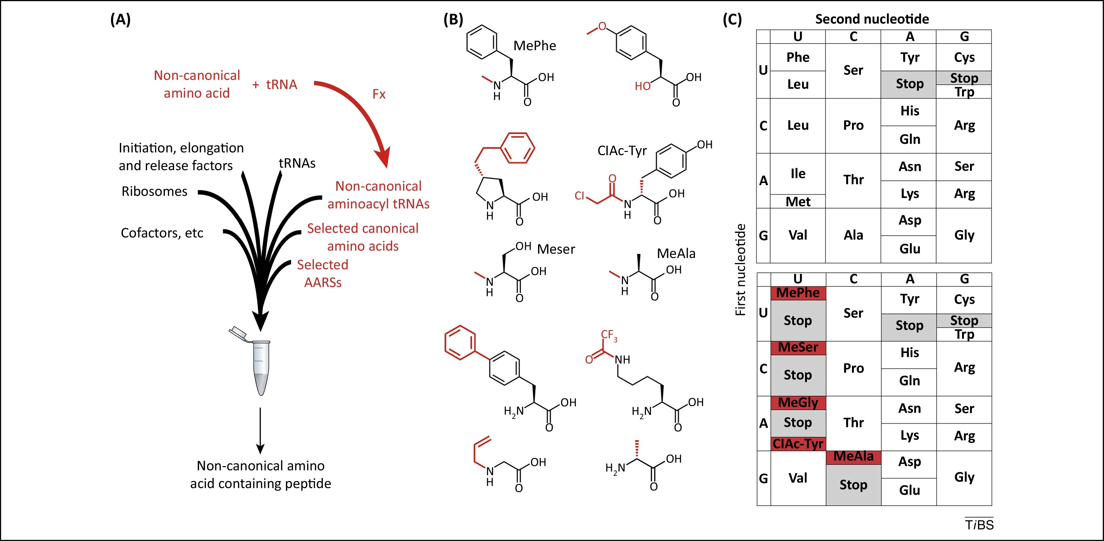
Metabolic Engineering
Reprogramming the genetic code
Enzyme engineering / directed evolution
Passioura et al. 2014
Fallah-Araghi et al. LOC 2012.

Slide 14
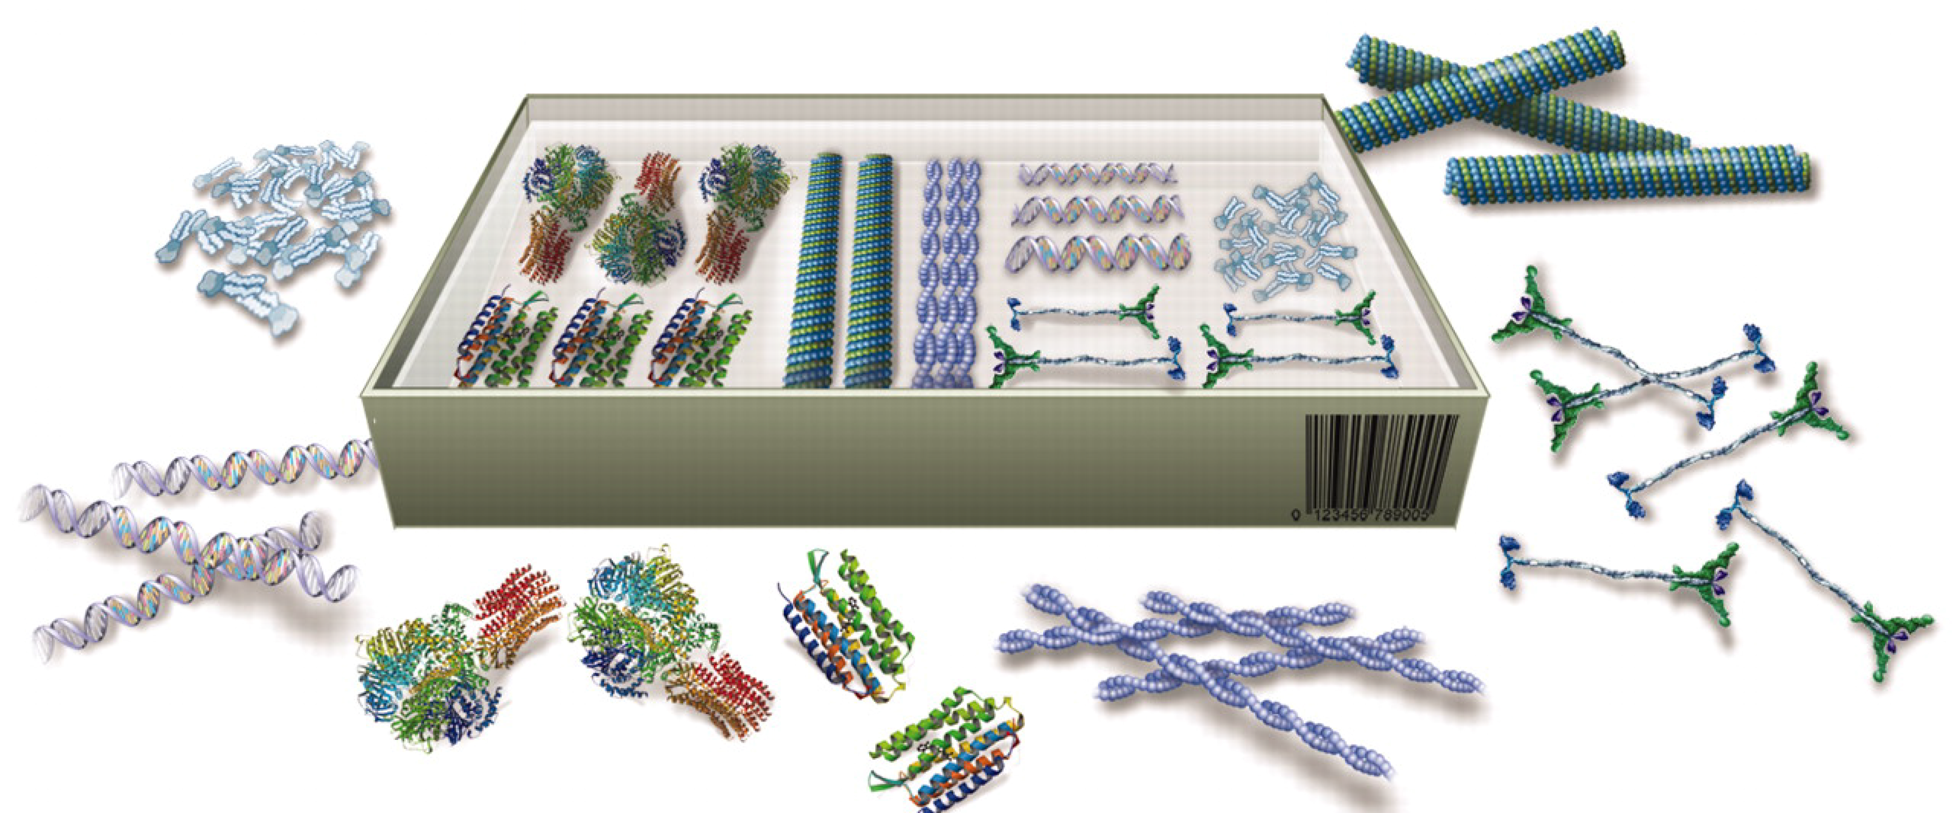
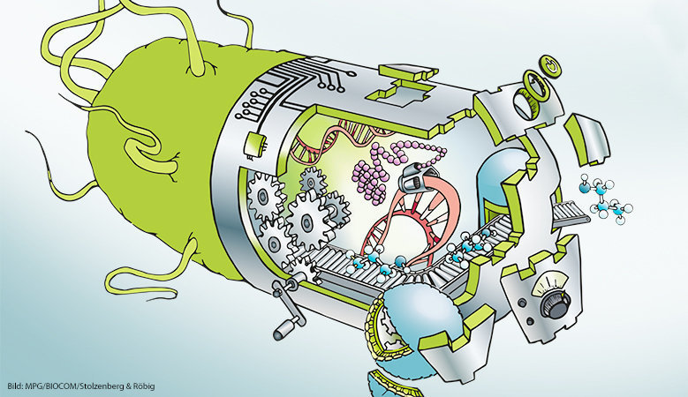
Basis for a synthetic cell
synthetische-biologie.mpg.de
adapted from: Schwille,Science 2011
synthetic biology as a toolbox

Slide 15

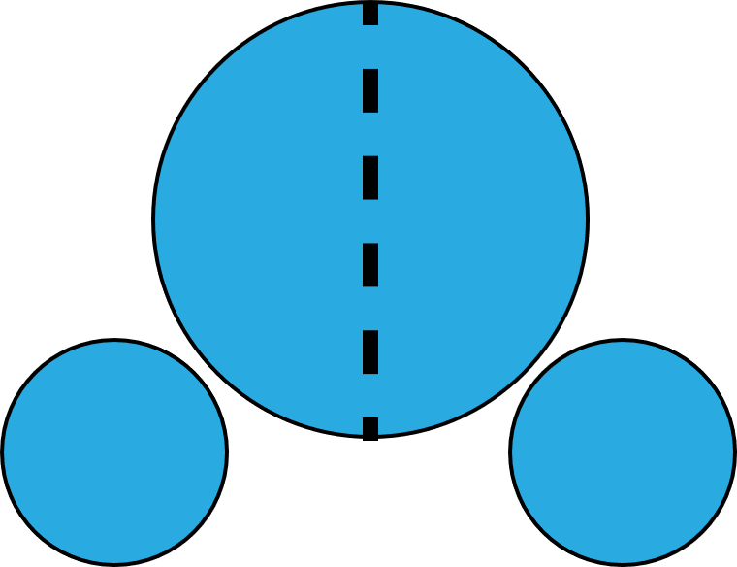
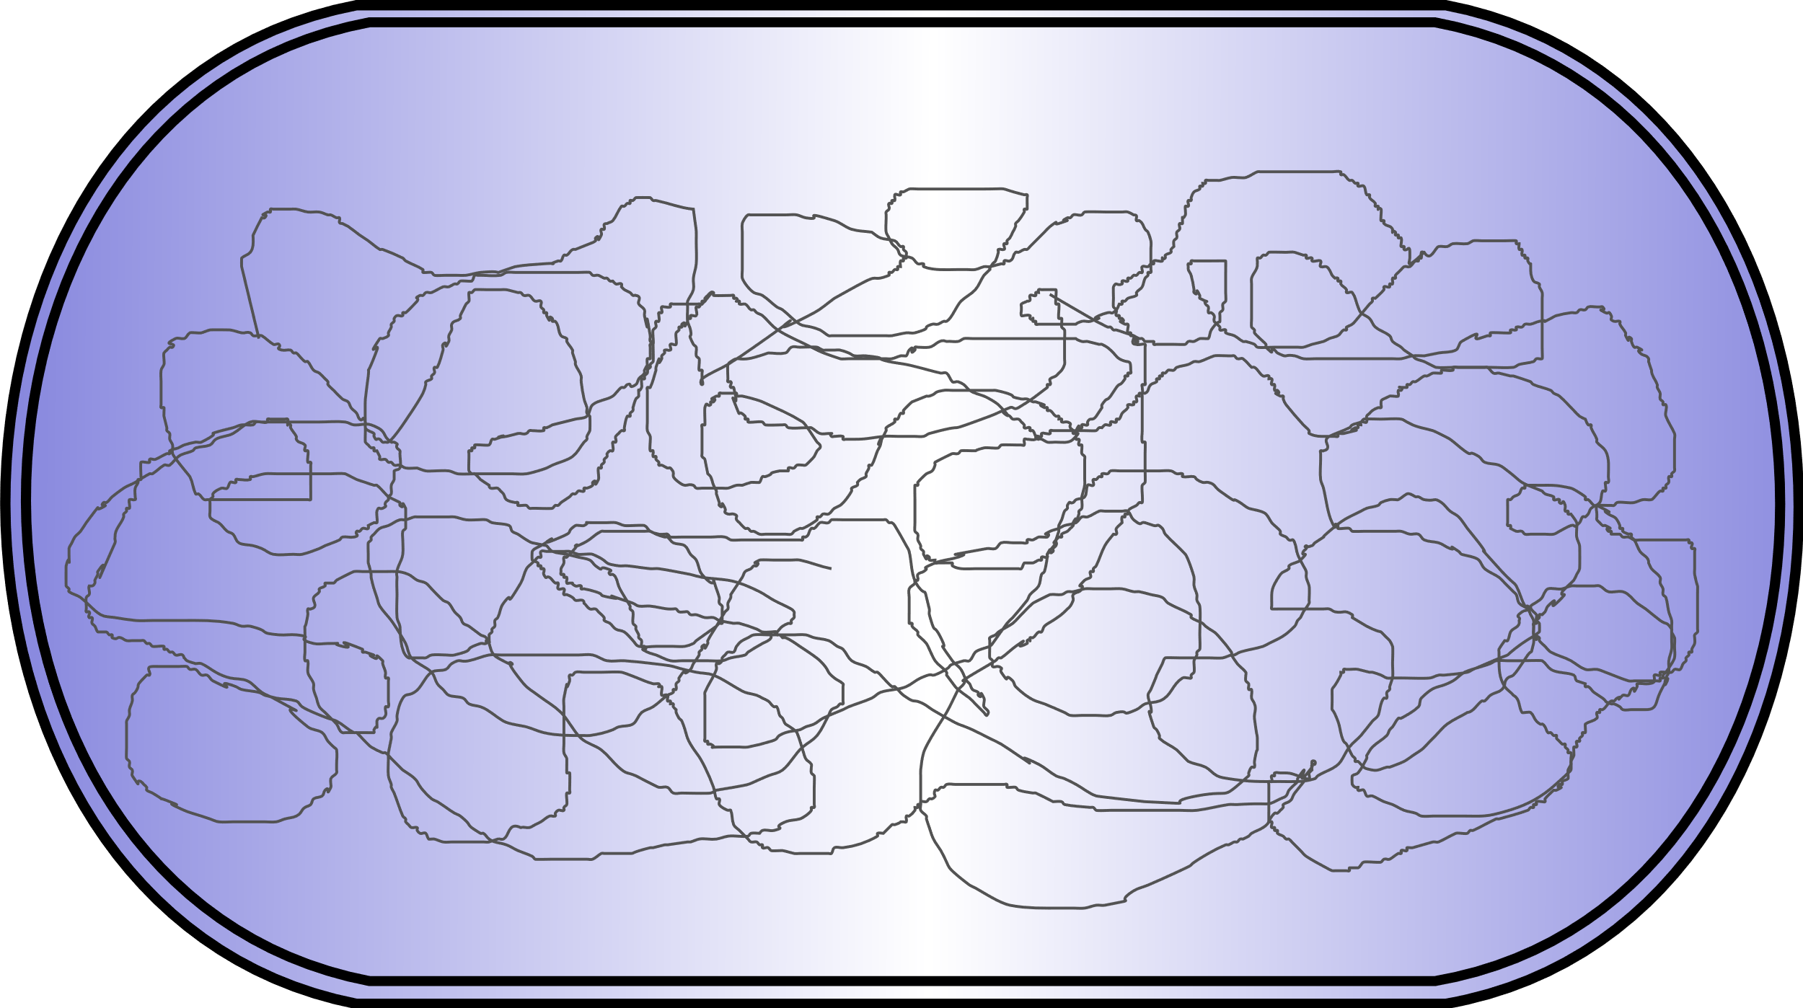
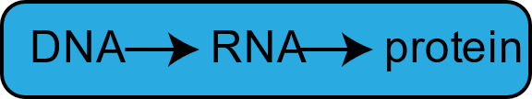

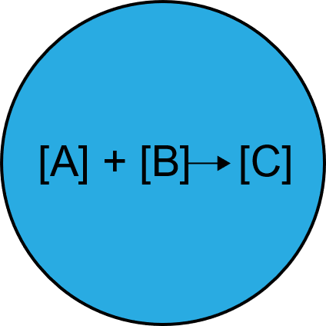

Basis for a synthetic cell
growth and
division
information processing
natural cell:
top – down approach
compartmen-talization
adapted from: Schwille,Science 2011
metabolism
synthetische-biologie.mpg.de
synthetic cell:
bottom – up approach
synthetic biology as a toolbox
adaptabiliy

Slide 16
What is it good for?
Understanding the concept of life in general and how life could have emerged
Ability to build it according to one‘s needs for:
  Healthcare
  Environmental remediation
  Sustainable energy conversion
  ...

Slide 17
Between wild type and omicron: Characterzizing binding strength of SARS-CoV-2 receptor binding domain variants

Slide 18
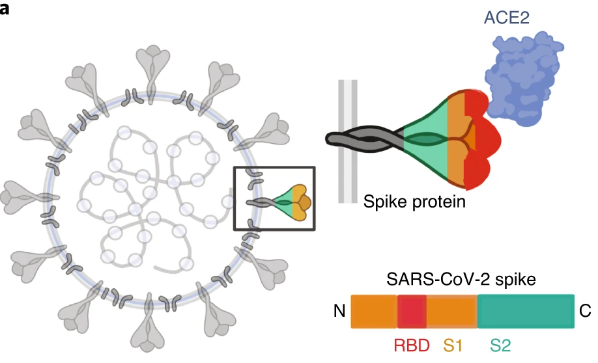
Receptor binding domain (rbd) of SARS CoV 2
Evolution of the virus → currently dominant variant: omicron
Differences in transmissibility and course of the disease
16 mutations in rbd between wt and omicron
Altered affinity in antibody binding
Altered affinity in binding to human Ace2 receptor?
adapted from: Huo et al., Nature, 2020

Slide 19
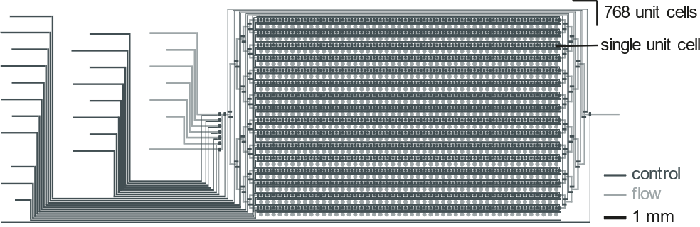
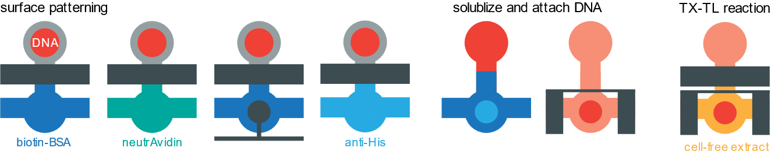

High-throughput screening of rbd variants using MITOMI and on-chip expression of rbd variants
rbd-GFP-His
Adapted from: Swank et al., 2019
Notes:
quick recap what I m doing: look at Covid pandemics you obviously noticed different variants and now dominant is omicron. Came along with differenct characteristics and progression of disease. Look at genome, you‘ll find a lot of mutations including the spike protein with its rbd which is the protein responsible for direct contact with human Ace2 receptor and thus entry into human cells. if you compare wt to o find 13-16 mutations in rbd alone, quite a lot, comparison to delta: only 3. We know that there is altered affinity towards antibodies against wt. not entirely sure yet is if there‘s altered affinity in binding to human Ace2 receptor.
want to do high throughput screening of mutants of rbd between wt and o to see how these mutations or better combinations of mutations influenced binding affinities. To give you an order of magnitude: if one were to test all possible mutations between wt and o would be 2^15 > 30.000 possibilities. not going to test all of them but the idea is to get like a thousand to a few thousand variants in. how we re going to do this: spot DNA for variant on chip, express it in PURE, flow respectively anti-spike or Ace2 and measure binding affinity. Go into details later.

Slide 20
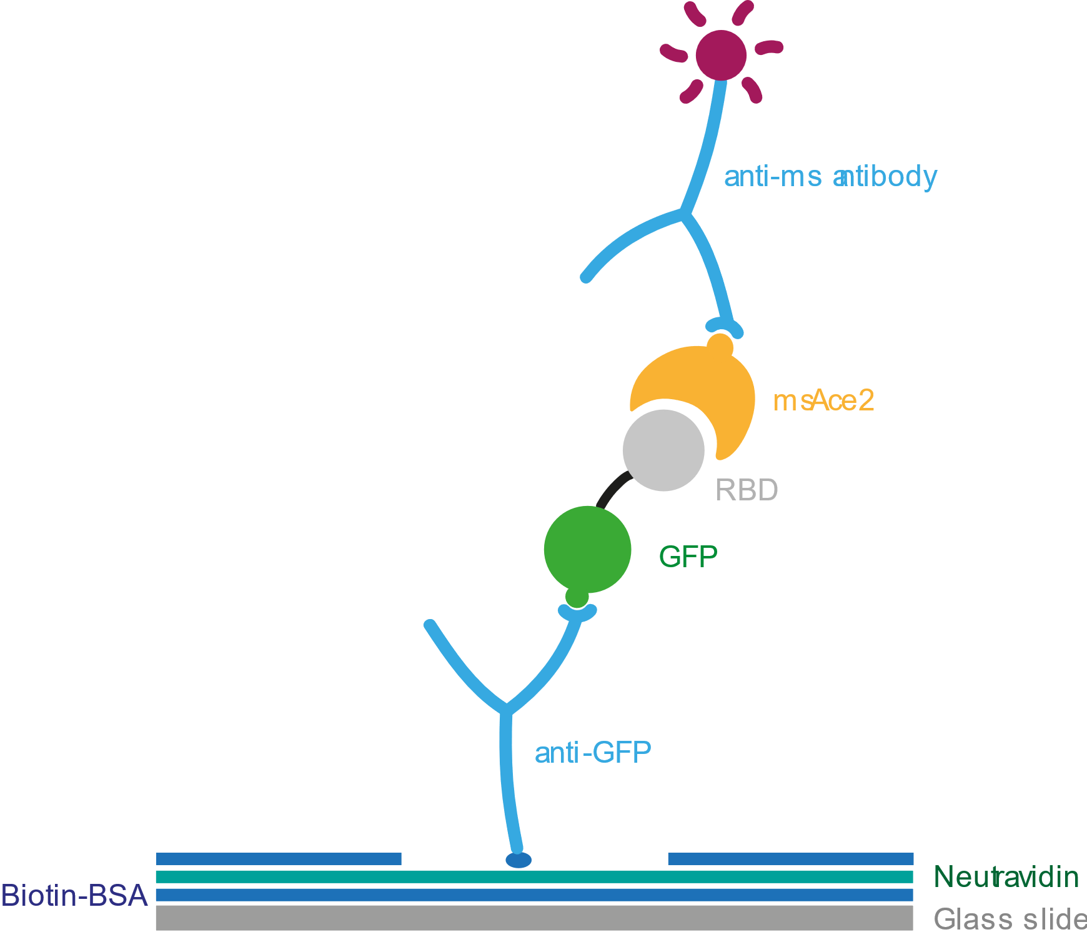
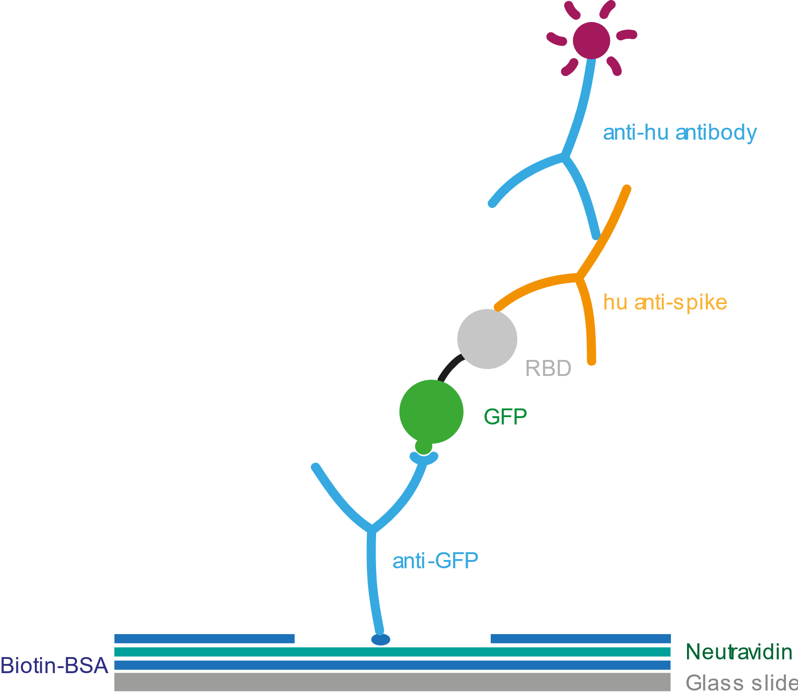
Binding assays
Binding of Ace2 receptor
Binding of anti-Spike antibody

Slide 21
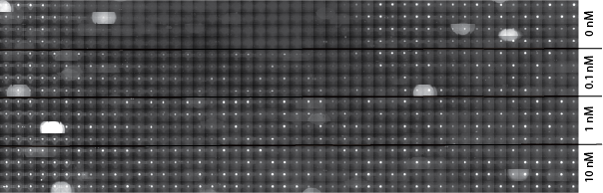
Binding assay: anti-spike binding wt vs omicron

